Slide 1
EnvEcon 0 - Origins
The origins of the problem
State of the environment
History of environmental and resource economics

Slide 2
0 Introduction
1 Social choice
2 Externalities and public goods
3 Decision analysis
4 Valuation: Aims and purpose
5 Valuation: Revealed preferences
6 Valuation: Stated preferences
7 Direct regulation
8 Market-based instruments
9 Imperfect information
10 Growth and the environment
11 Green accounting

Slide 3
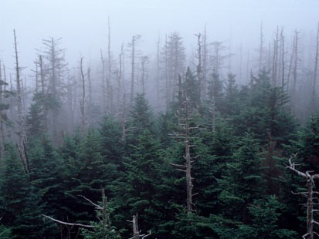
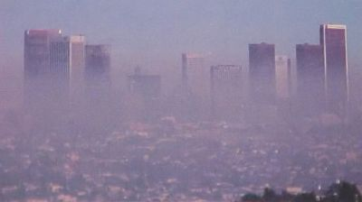
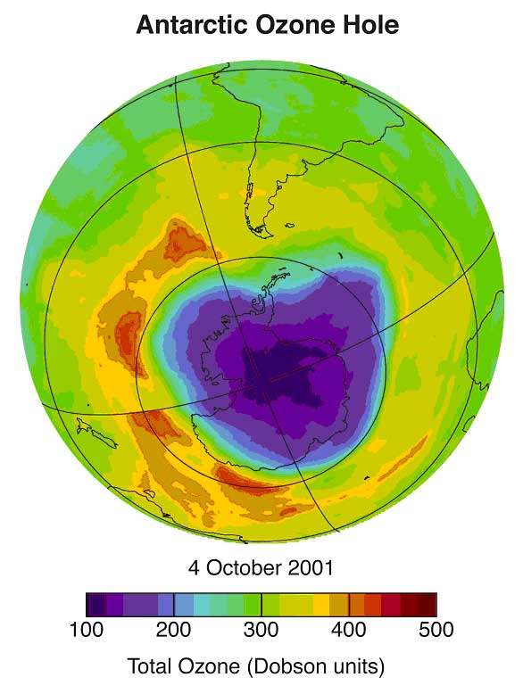
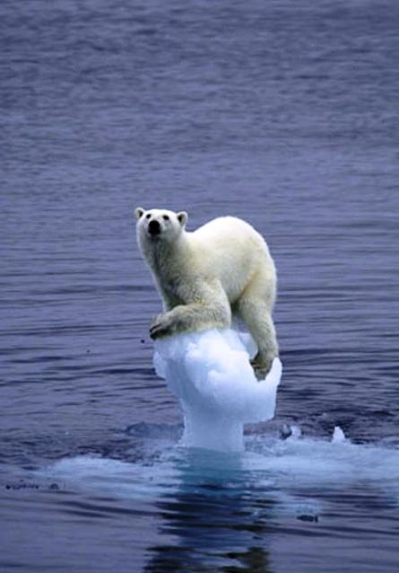
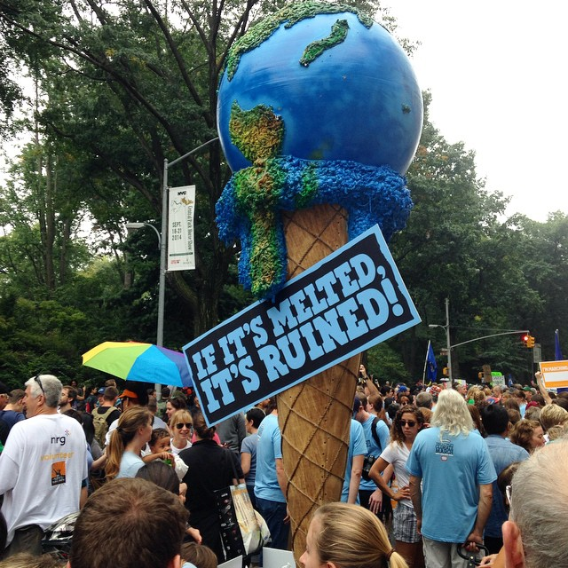

Slide 4
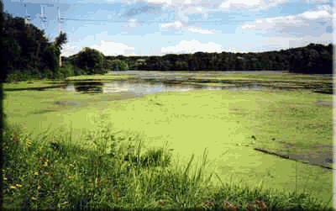
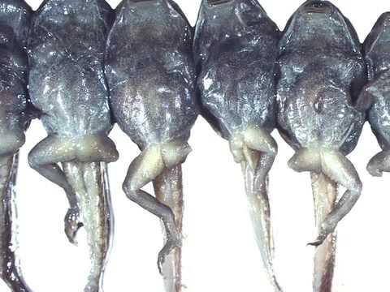
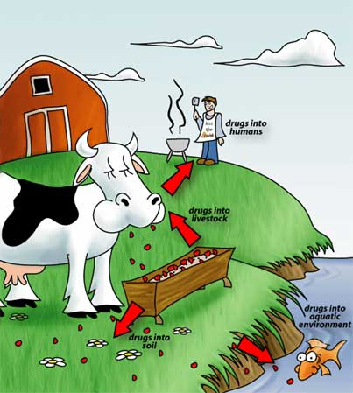
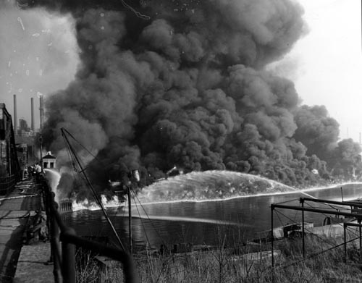

Slide 5
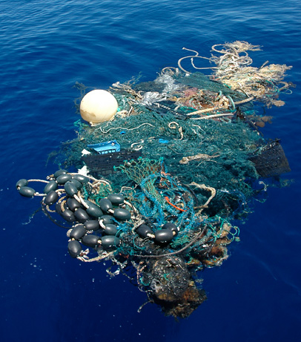
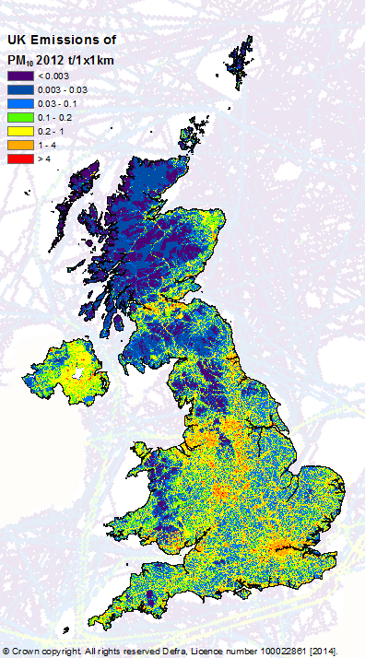
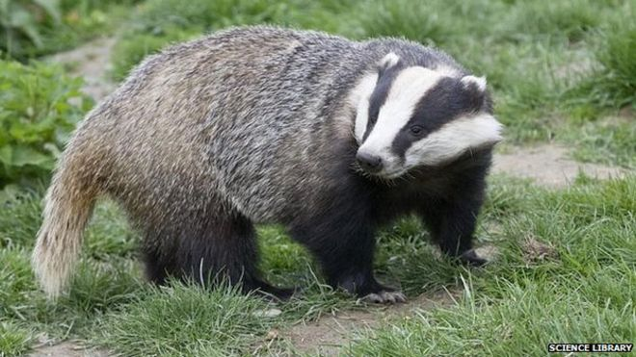
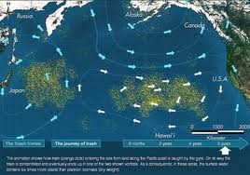

Slide 6
The Emergence of Environmental and Resource Economics
Classical economics
Neo-classical economics
Welfare economics
Environmental economics

Slide 7
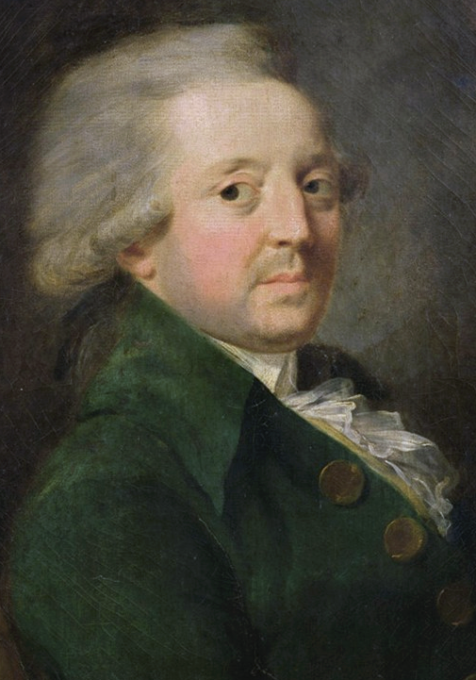
Proto-Economics
Condorcet (1776): Agricultural activity that by corrupting the air, causes illnesses in neighbouring homes
King Edward I had earlier (1273, 1306) coal in London

Slide 8
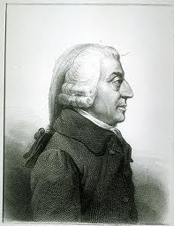
Classical Economics
Smith: invisible hand of general equilibrium, social good by individual action
Except for … erecting and maintaining certain publick works and certain public institutions … because the profit would never repay the expence to any individual, … though it may frequently do much more than repay it to a great society
Malthus: growing population, diminishing returns to scale in agriculture
Ricardo: diminishing returns to scale (intensive margin), diminishing quality (extensive margin)
Mill (1857): innovation, input substitution; amenity value „it is only in backward countries of the world that increased production is still an important object[ive]“

Slide 9
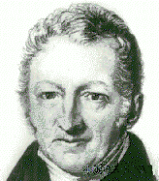
Classical Economics
Smith: invisible hand of general equilibrium, social good by individual action, public goods
Malthus: growing population, diminishing returns to scale in agriculture
Ricardo: diminishing returns to scale (intensive margin), diminishing quality (extensive margin)
Mill (1857): innovation, input substitution; amenity value „it is only in backward countries of the world that increased production is still an important object[ive]“

Slide 10
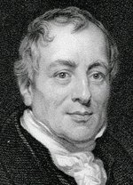
Classical Economics
Smith: invisible hand of general equilibrium, social good by individual action , public goods
Malthus: growing population, diminishing returns to scale in agriculture
Ricardo: diminishing returns to scale (intensive margin), diminishing quality (extensive margin)
But like all Classical economists, Ricardo believed that economic growth would end
Mill (1857): innovation, input substitution; amenity value „it is only in backward countries of the world that increased production is still an important object[ive]“

Slide 11
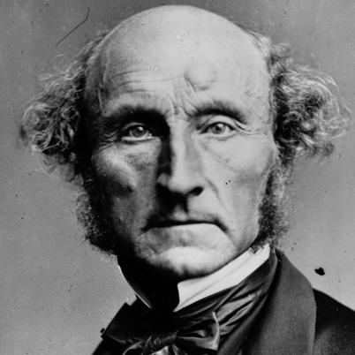
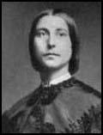
Classical Economics
Smith: invisible hand of general equilibrium, social good by individual action , public goods
Malthus: growing population, diminishing returns to scale in agriculture
Ricardo: diminishing returns to scale (intensive margin), diminishing quality (extensive margin)
Mill (1857): innovation, input substitution; amenity value „it is only in backward countries of the world that increased production is still an important object[ive]“

Slide 12

Classical Economics -2
Mill (1857): There is room in world, no doubt, for a great increase in population, supposing the arts of life to go on improving, and capital to increase. [...] The density of population necessary to obtain all of the advantages both of cooperation and of social intercourse [...] has been attained. A population may be too crowded, though all be amply supplied with food and raiment. [...] Nor is there much satisfaction in contemplating the world with nothing left to the spontaneous activity of nature

Slide 13
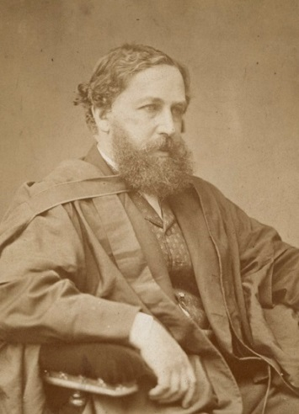
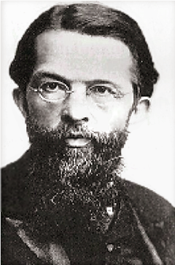
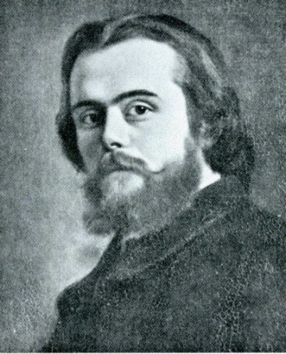
Neo-Classical Economics
Value is relative, determined in exchange, reflecting preferences, production costs and scarcity
Demand and supply, partial and general equilibrium
Absolute scarcity no longer seen as a problem
A reflection of the times
Push into Africa, India, American West
Rapid technological progress
Rapid industrialization

Slide 14
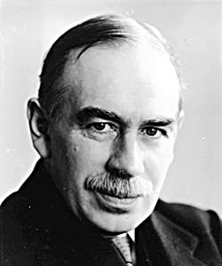
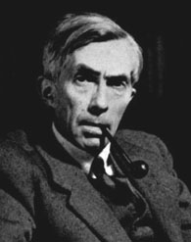
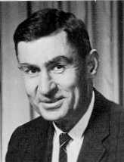
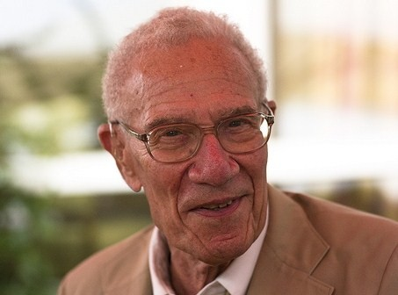
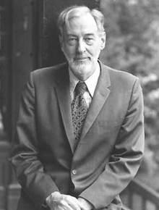
Keynesian and Modern Economics
Keynes‘ macro-economics indirectly reinvoked interest in economic growth
Early growth models: no resource limits

Slide 15
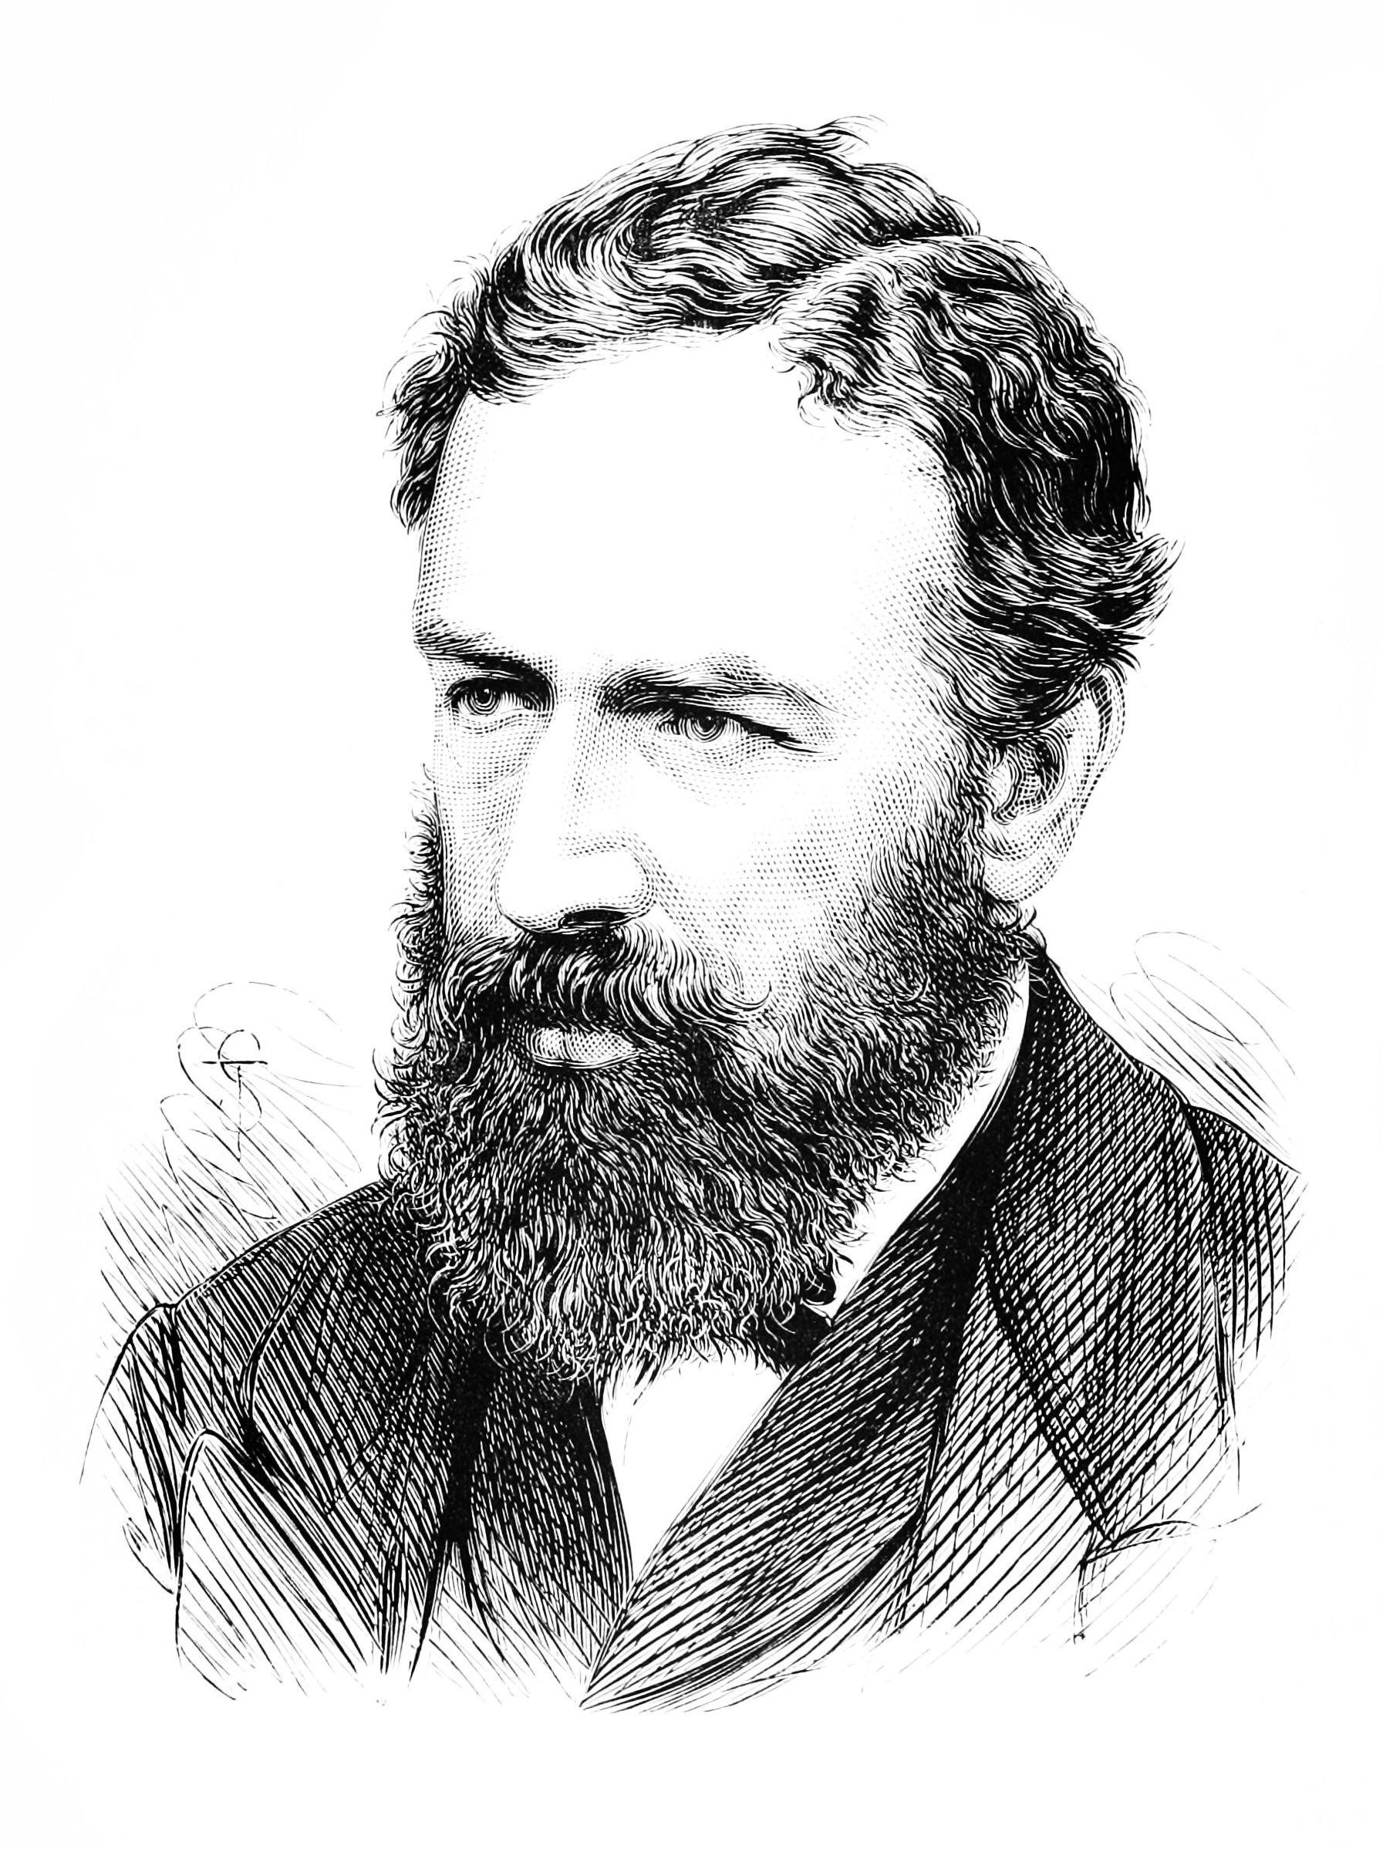
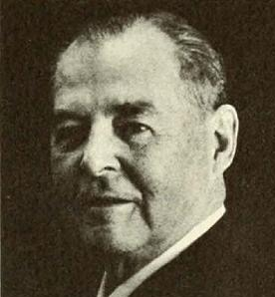
Keynesian and Modern Economics
The Great Depression and Keynes’ macro-economics and indirectly reinvoked interest in economic growth
Early growth models: no resource limits
Jevons (1865) anticipated that we will eventually run out of coal
Hotelling (1931) worked on the economics of exhaustible resources

Slide 16
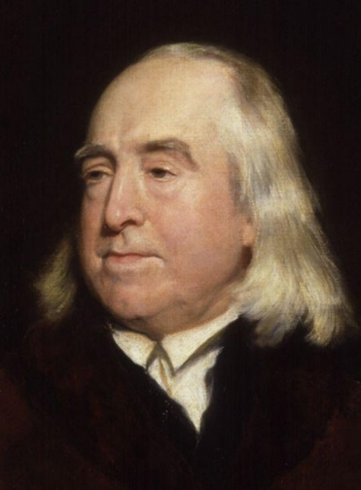
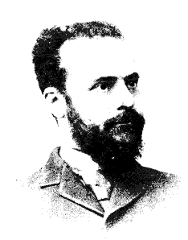
Welfare Economics
Rigorous theory of social good
Utilitarianism: Social good is the weighted sum of individual good
Pareto optimality: At least as good for all, better for one
Actual and potential (after transfers)
Marshall and Pigou: Externalities and taxes – if there are unintended and uncomponsated consequences of one agent to the next, the market transactions need not be Pareto improving – Pigou taxes can counteract this

Slide 17
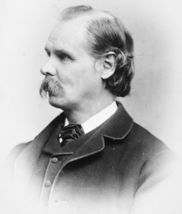
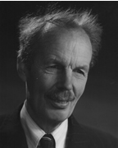
Welfare Economics
Rigorous theory of social good
Utilitarianism: Social good is the weighted sum of individual good
Pareto optimality: At least as good for all, better for one (actual and potential)
Marshall: Externalities – if there are unintended and uncomponsated consequences of one agent to the next, the market transactions need not be Pareto improving
Pigou: Taxes can counteract this
Marshall also worked on overexploitation of common property

Slide 18
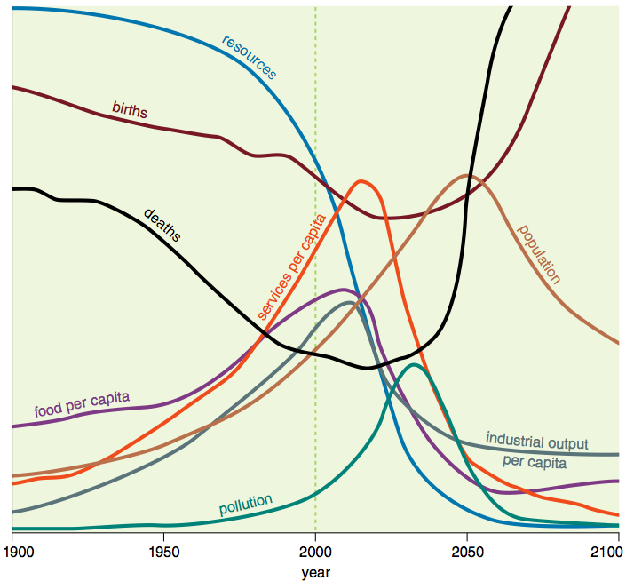
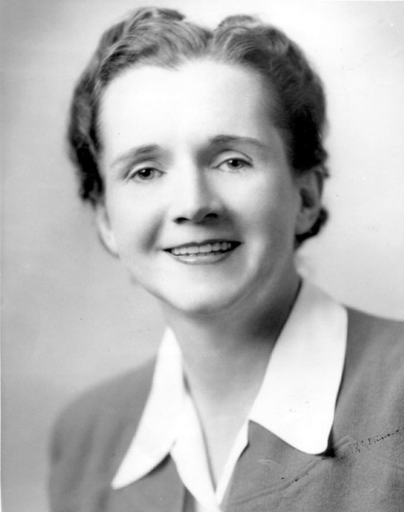
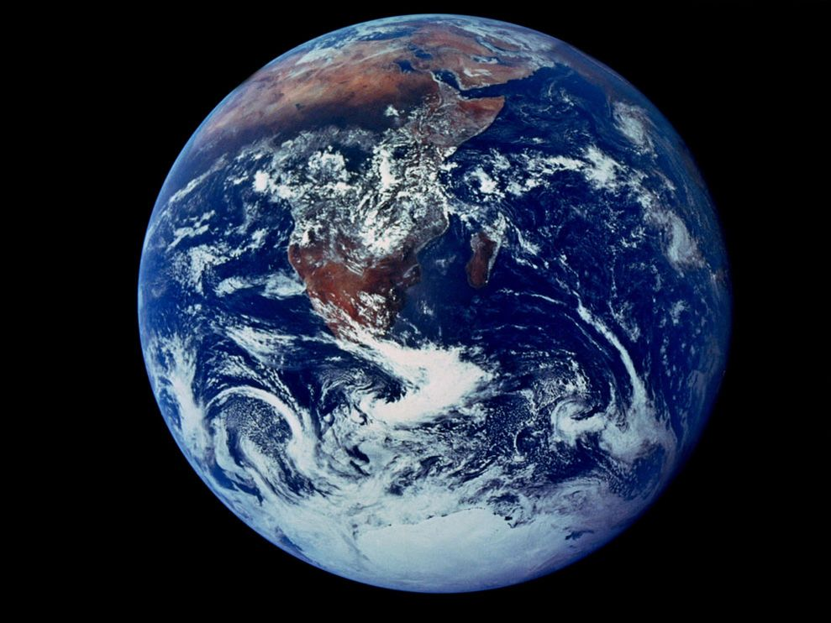
Environmental & Resource Economics
In the 1960s and 70s, things changed: Limits to Growth, Silent Spring, oil crisis, pollution, space travel, congestion
Natural resources are scarce
Environmental services are valuable
There are significant environmental externalities

Slide 19
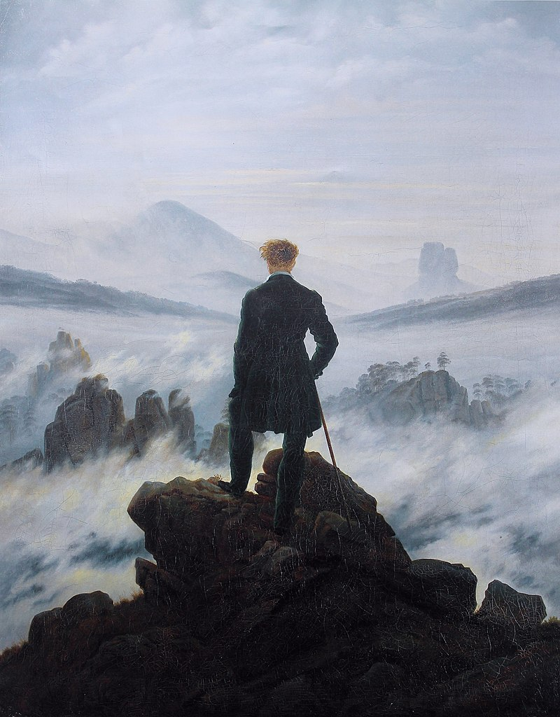
Romanticism vs Enligthenment
1770-1850
Emotions vs reasons
Beautiful vs dangerous nature
Harking for a simpler past
Three successors
Communism
Nazism
Naturalism & Environmentalism

Slide 20
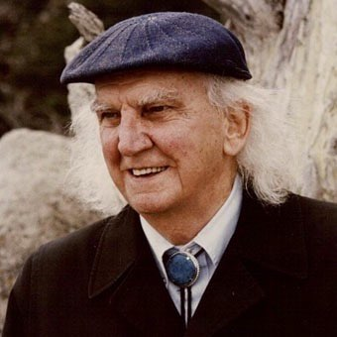
Environmental & Resource Economics
In the 1960s and 70s, things changed: Limits to Growth, Silent Spring, oil crisis, pollution, space travel, congestion
Natural resources are scarce
Environmental services are valuable
There are significant environmental externalities
Boulding: Anyone who believes exponential growth can go on forever in a finite world is either a madman or an economist

Slide 21
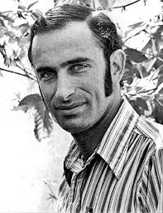
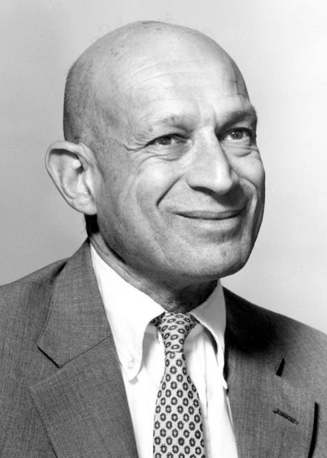
Ehrlich v Simon
"Sometime in the next fifteen years, the end will come. And by 'the end' I mean an utter breakdown of the capacity of the planet to support humanity." (Ehrlich, 1970)
Paul R. Ehrlich is a biologist, key figure in Club of Rome
Julian L. Simon is an economist, who took issue
Wager that prices of copper, chromium, nickel, tin and tungsten would go up (Ehrlich) or down (Simon)
Simon won
Ultimate resource is human ingenuity

Slide 22
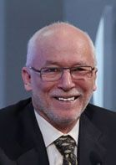
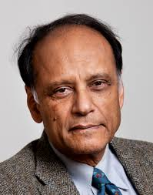
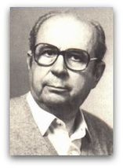
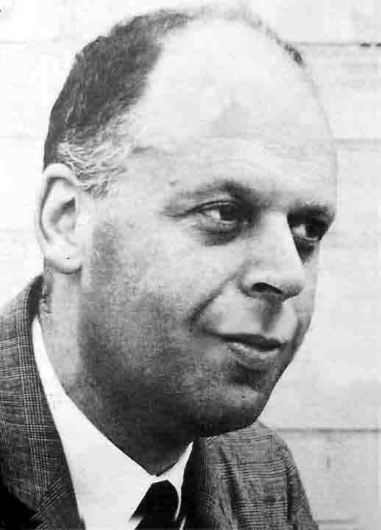
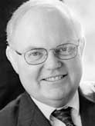
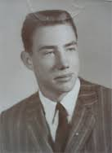
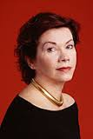
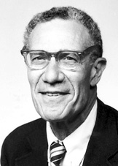
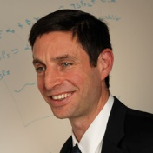
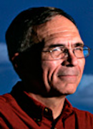





Slide 23
Environmental & Resource Economics
Environmental and resource economics has now become a respectable field
Many US & UK universities offer an education programme
There are specialised journals, including JEEM, REEP, JAERE, REE, ERE, EPA, LE while general journals and conferences have regular sessions on environmenta & resource economics
Leading economists like Acemoglu, Arrow, Baumol, Bradford, Jorgenson, Nordhaus, Sachs, Schelling, Solow, Stiglitz
And we got the Nobel Prize

